Slide 1
Analysis-Based Program Transformations
Presentation for HOPL
2/3/17

Slide 4
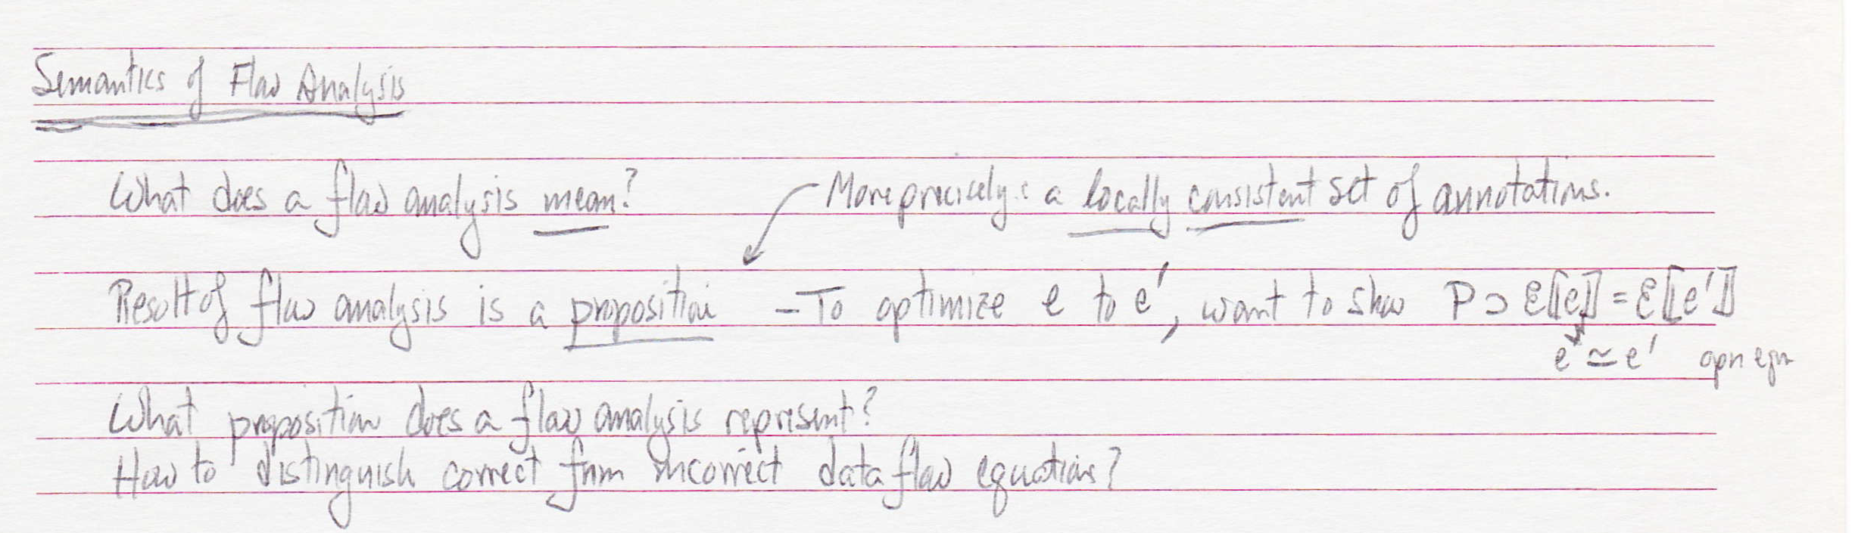

Slide 5
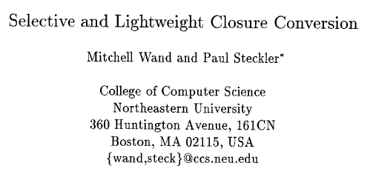
POPL ‘94

Slide 7
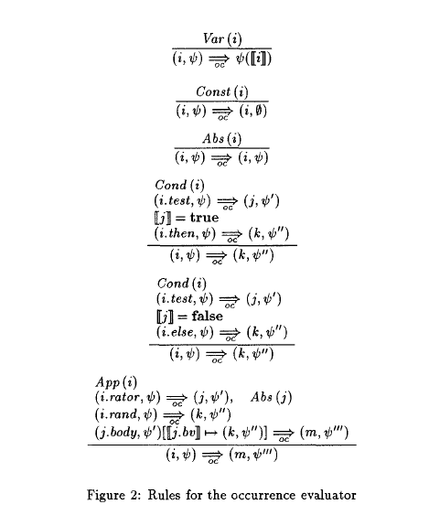

Slide 9
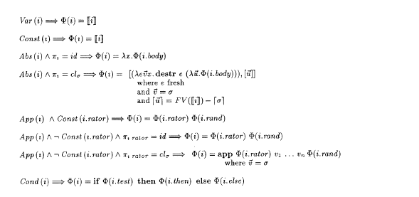

Slide 11
FPCA ‘93

Slide 12
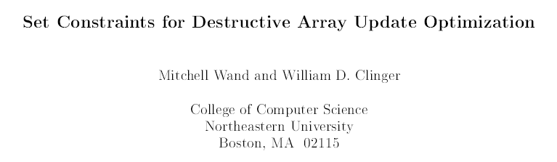
IEEE Conference on Computer Languages 1998
long version in JFP 2001

Slide 13

[push]
[return]

Slide 14
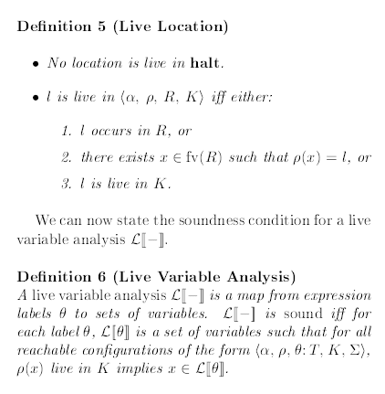

Slide 15

$F_{0}^{∗}$ is the transformed version of $F_{0}$, based on $ℒ$

